Slide 1
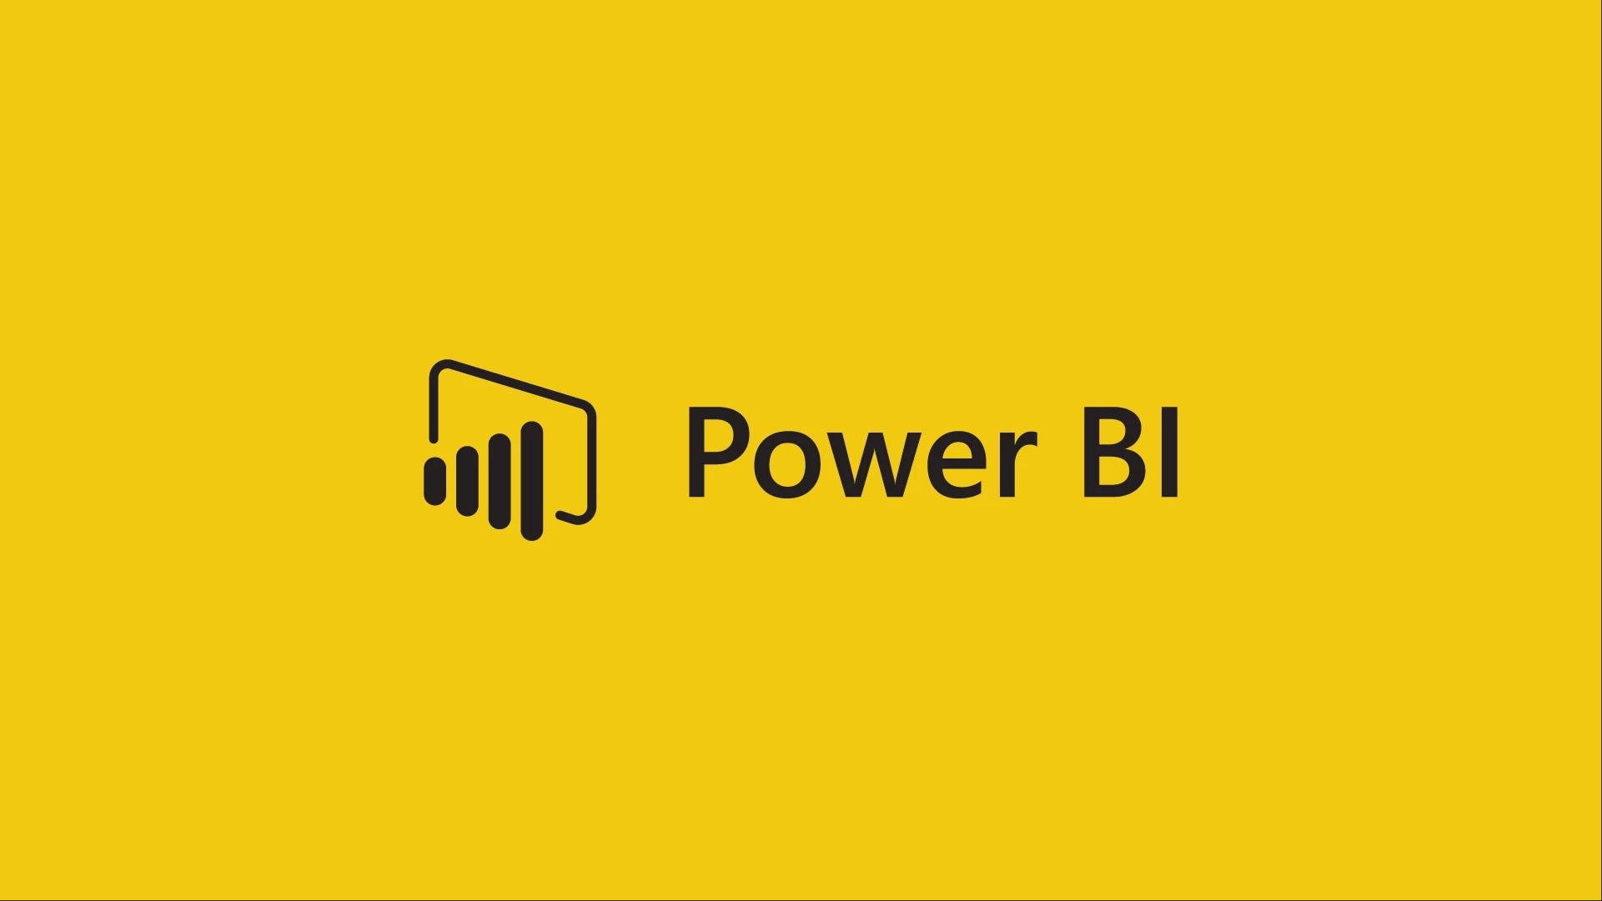

Slide 2
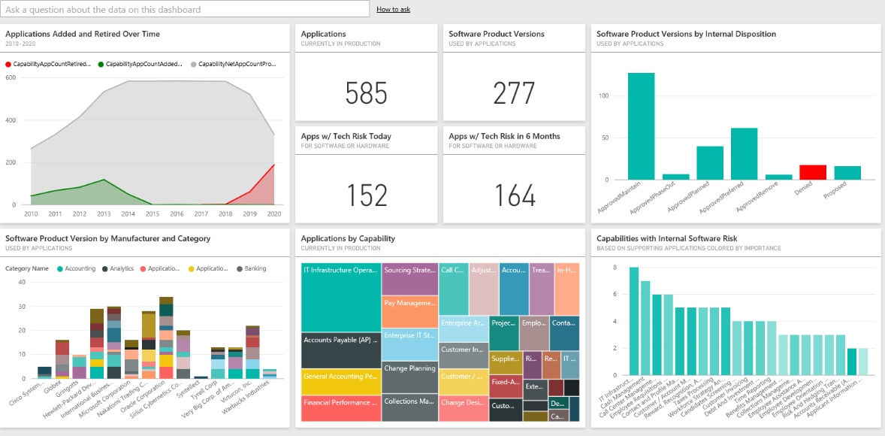
Power BI is a cloud-based business analytics
service that enables
• fast and easy access to your data
• a live 360º view of your business
• data discovery and exploration
• insights from any device
• collaboration across your organization
• anyone to visualize and analyze data

Slide 3
Key components
Power BI Desktop
The Windows-desktop-based application for PCs and desktops.
Power BI (Service)
The SaaS (software as a service) based online service (formerly known as Power BI for Office 365, now referred to as PowerBI.com or simply Power BI).
Power BI Mobile Apps
The Power BI Mobile apps for Android and iOS devices, as well as for Windows phones and tablets.
Power BI Gateways
Gateways used to sync external data in and out of Power BI.
Power BI Embedded
Power BI REST API can be used to build dashboards and reports into the custom applications that serves Power BI users, as well as non-Power BI users.

Slide 4
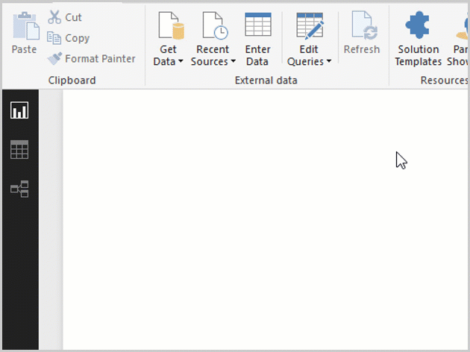
Data Sources

Slide 5
Installing Power BI
https://powerbi.microsoft.com/en-us/desktop/

Slide 6
How to use attached files
During the course I will be working on various Power BI projects and the reports will be available for you to download and work on.
To edit the data in the same file you have to change the path of the excel file to your location.

Slide 7
Power BI Pricing
Power BI Desktop Power BI Pro Power BI Premium Power BI Embedded
Licensed by Licensed by Licensed by Licensed by
User User Capacity Capacity
Free $9.99 Capacity pricing Capacity pricing
More Details - https://powerbi.microsoft.com/en-us/pricing/

